Slide 1
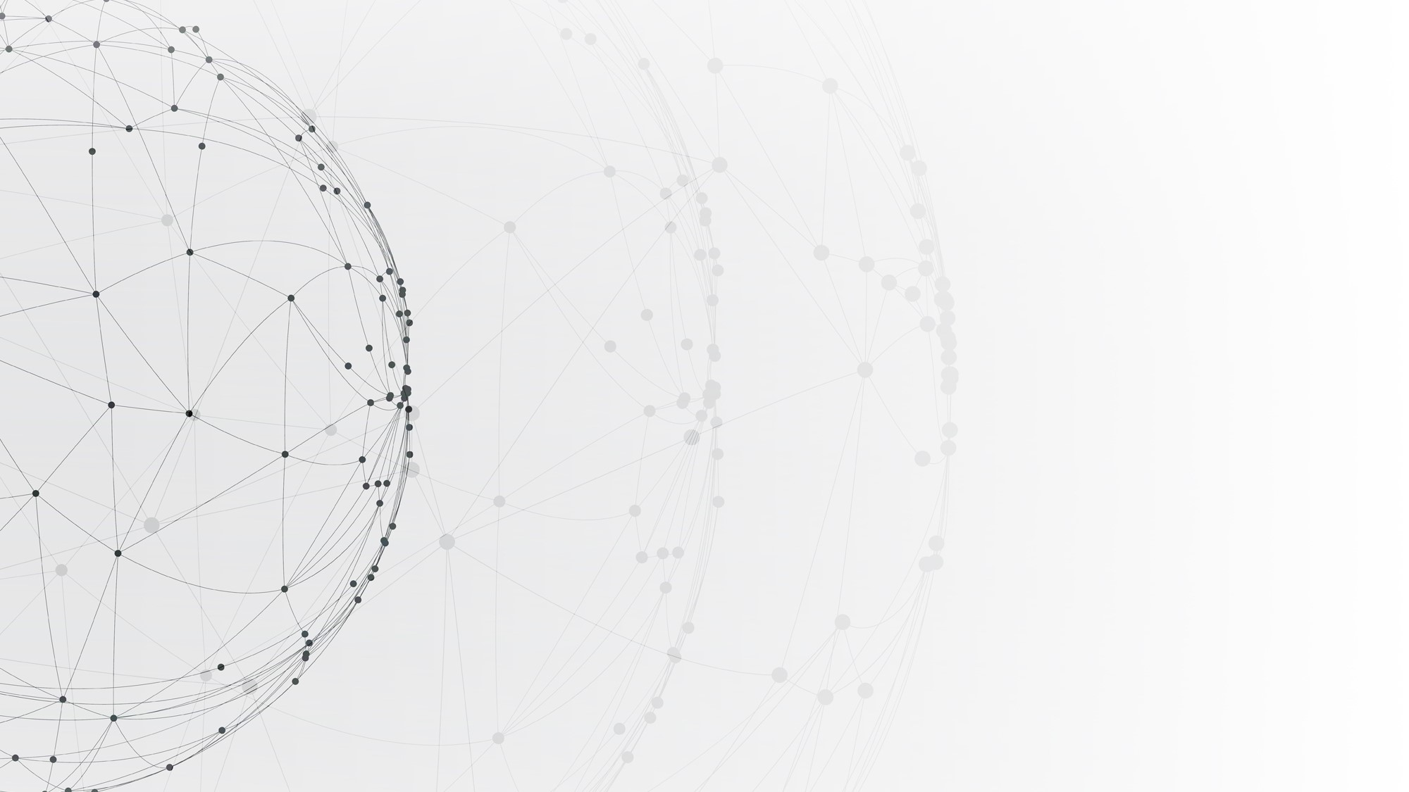
Crimes in Boston Prediction
Wei Jiang
Ci Chu
Kaikang Zhu

Slide 2
01
Project Architecture
02
Outline
Data Cleaning & Key Features
03
Visualization & Interaction
04
Modeling

Slide 3
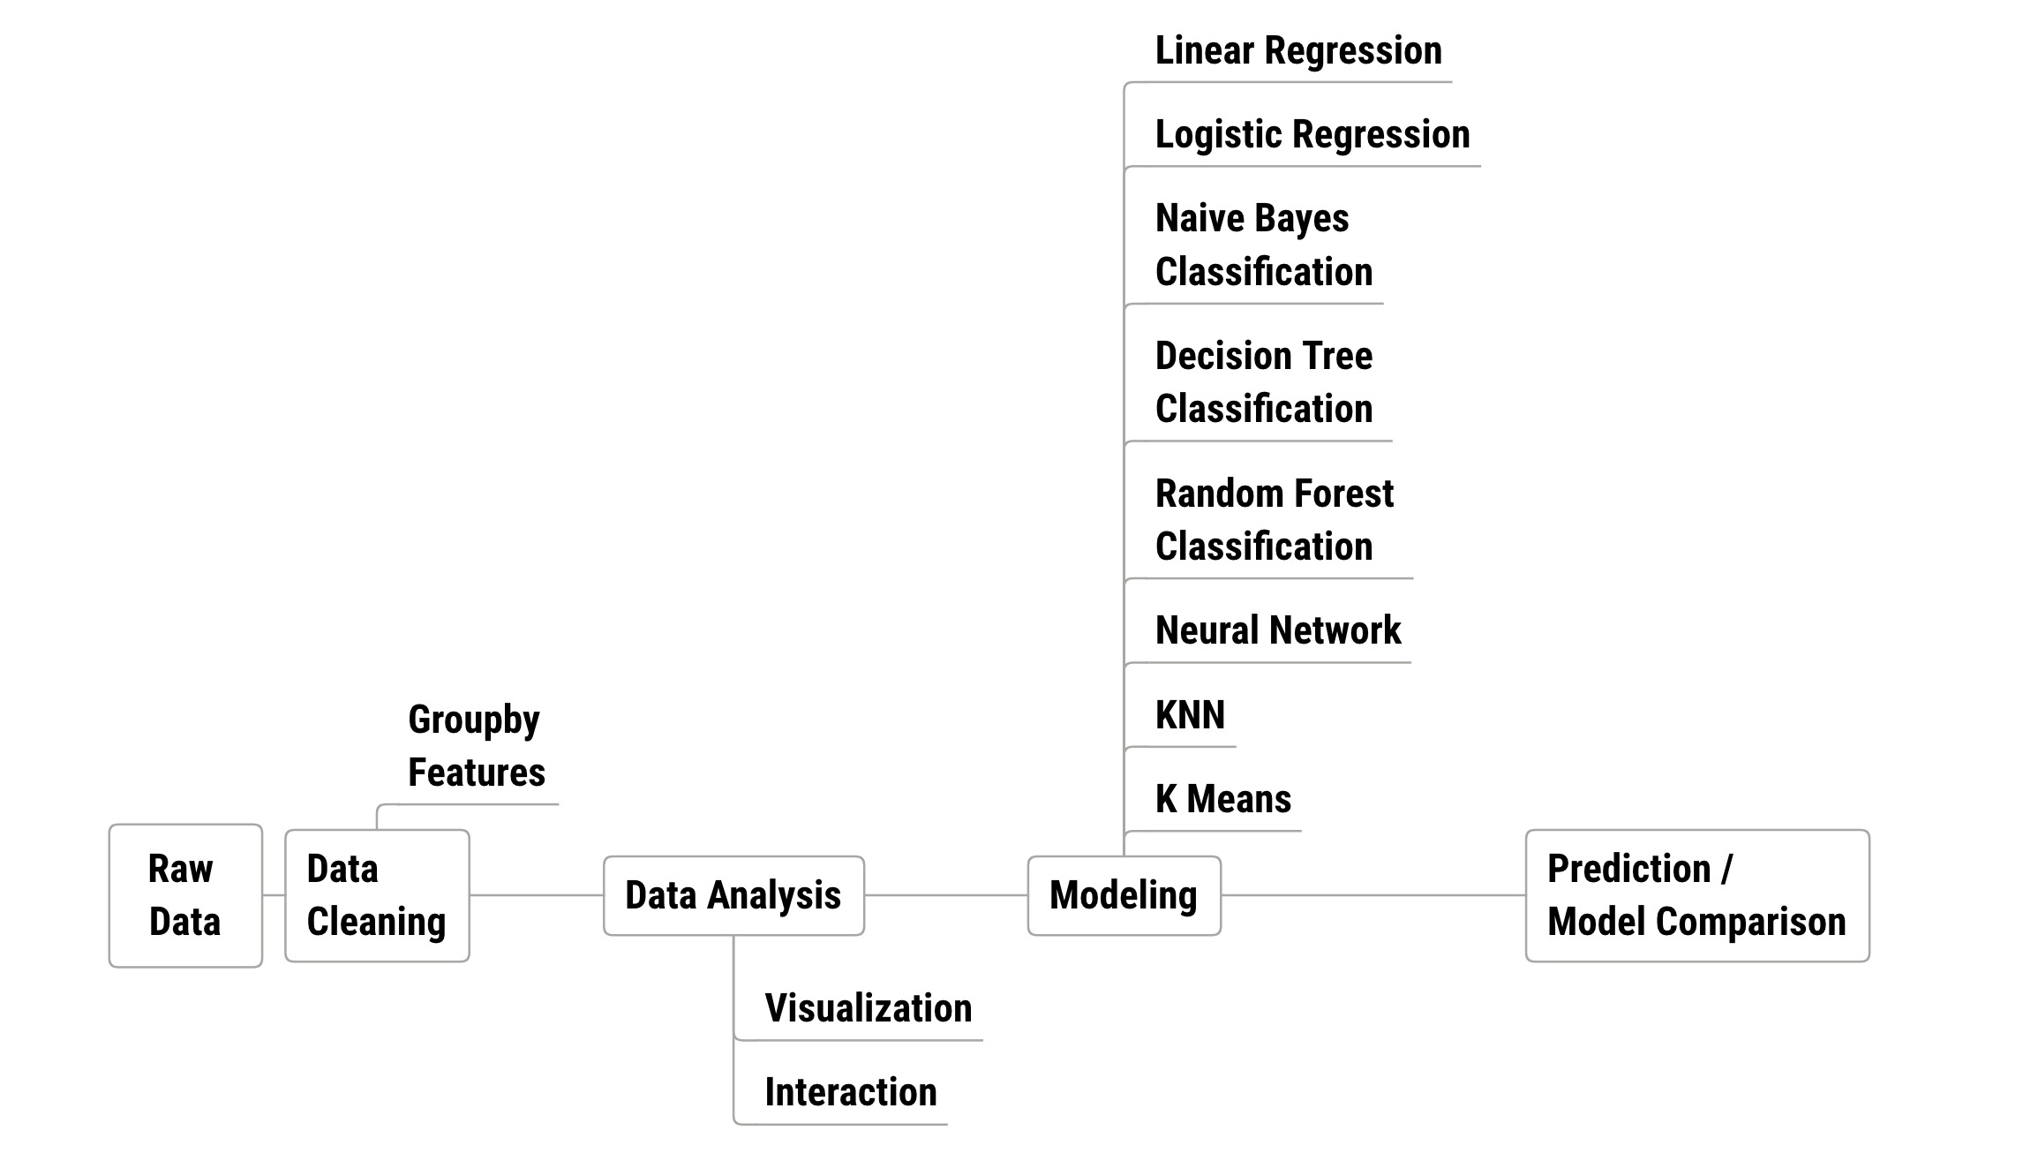
Project Architecture

Slide 4
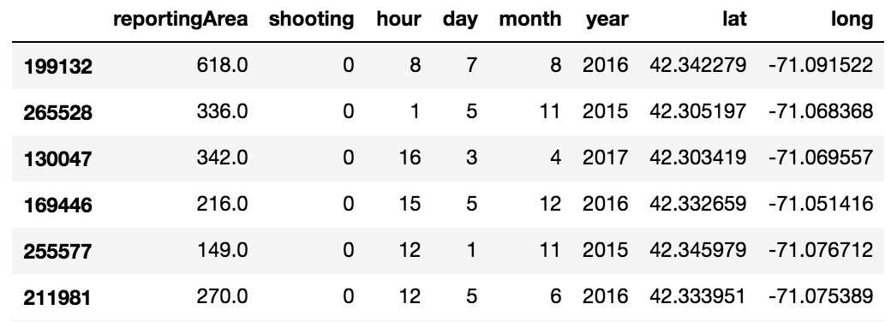
Data Cleaning & Key Features
Reporting area: Areas where crimes happened, preprocessed with pandas.to_numeric and one hot encoder
Shooting: whether crimes contain shooting or not
Hour, Day, Month, Year: Specific time for crimes
Lat, Long: Latitude and Longitude for crime cases
Offense Group: Group which crimes belong to, ex: Motor Vehicle Accident Response, Larceny

Slide 5
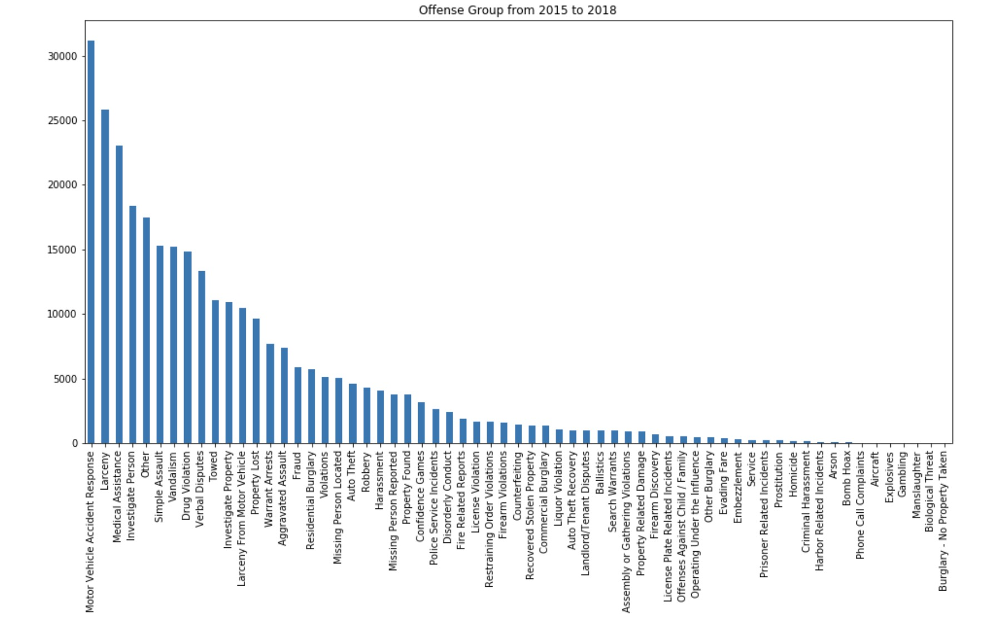
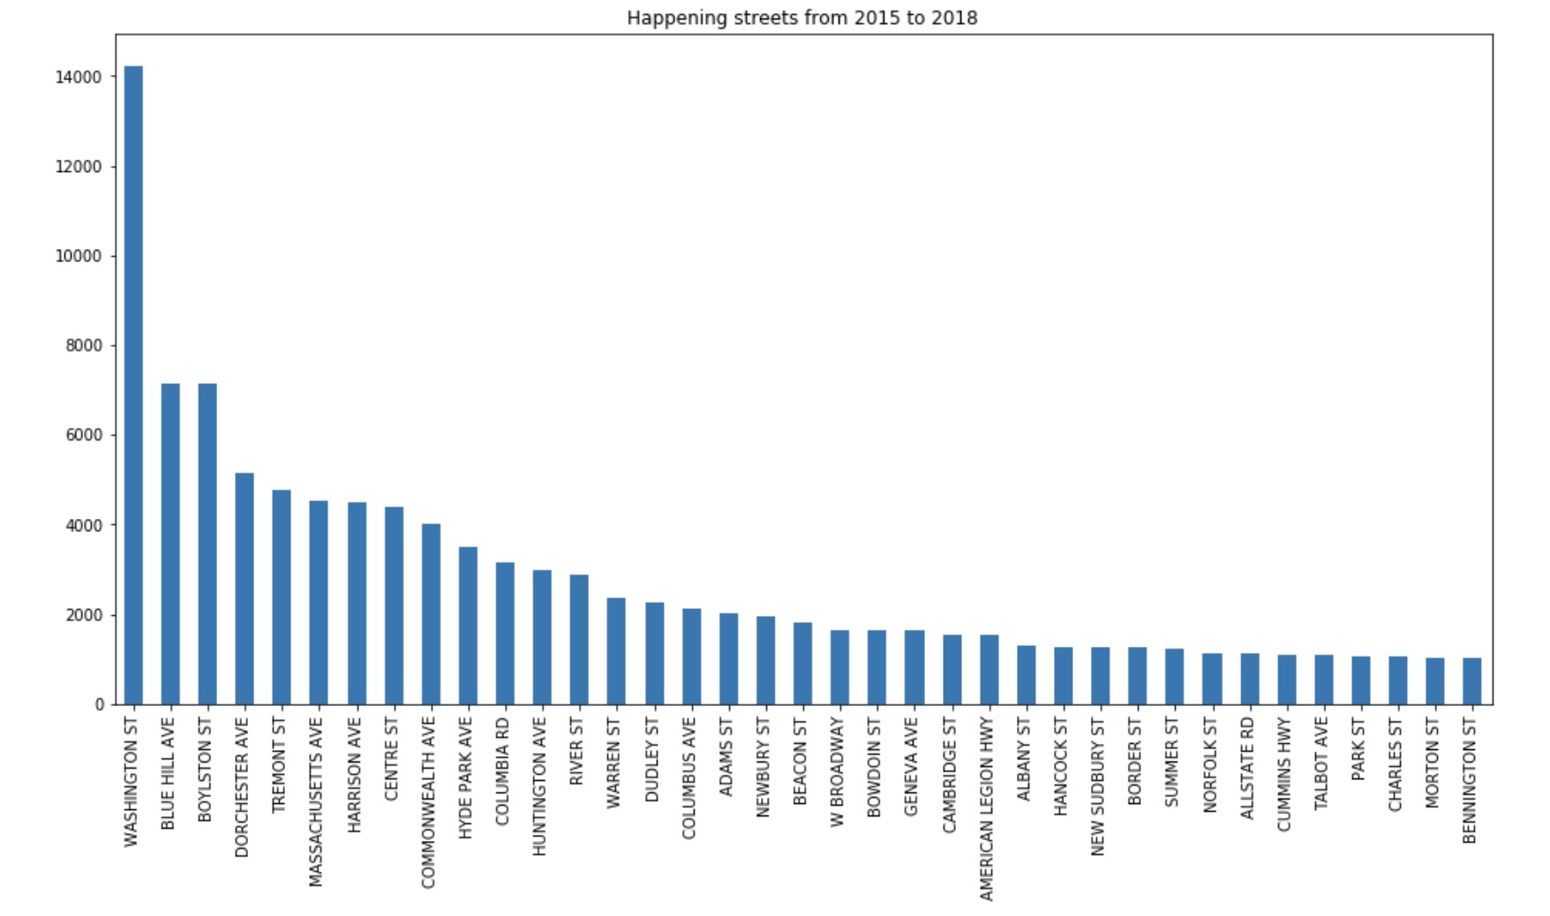
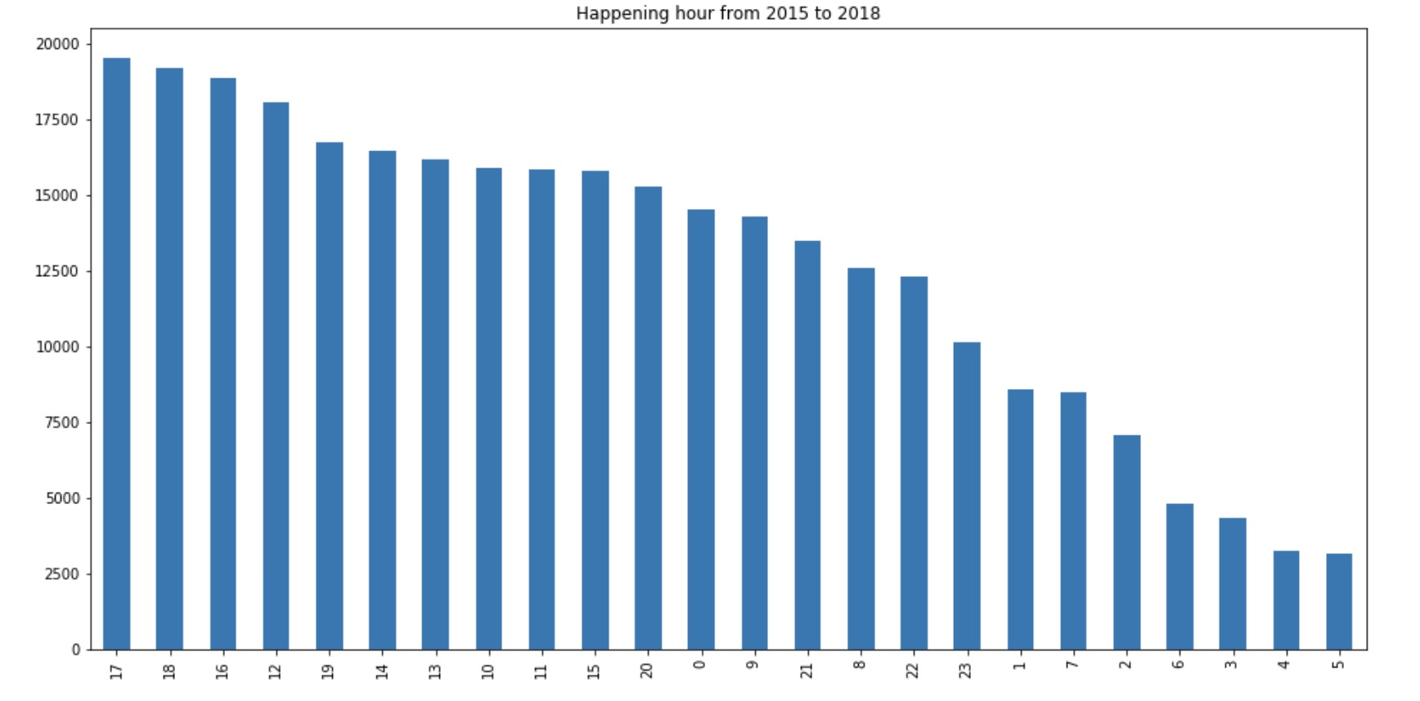
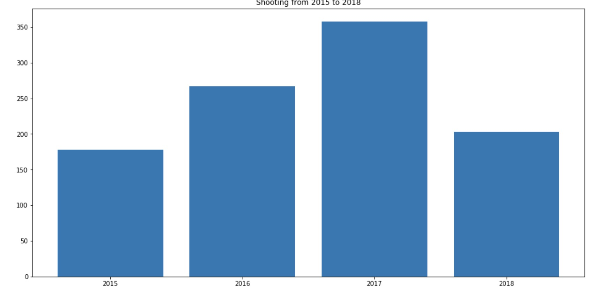
Data Visualization & Interaction
Offense Group bar chart
Head OG:
Motor Vehicle Accident Response, Larceny
Happen Streets bar chart
Head HS:
Washington St, Blue hill ave
Happen Hour bar chart
Head HH:
17, 18, 16, 12
Shooting Year bar chart
Head SY:
2017, 2016

Slide 6
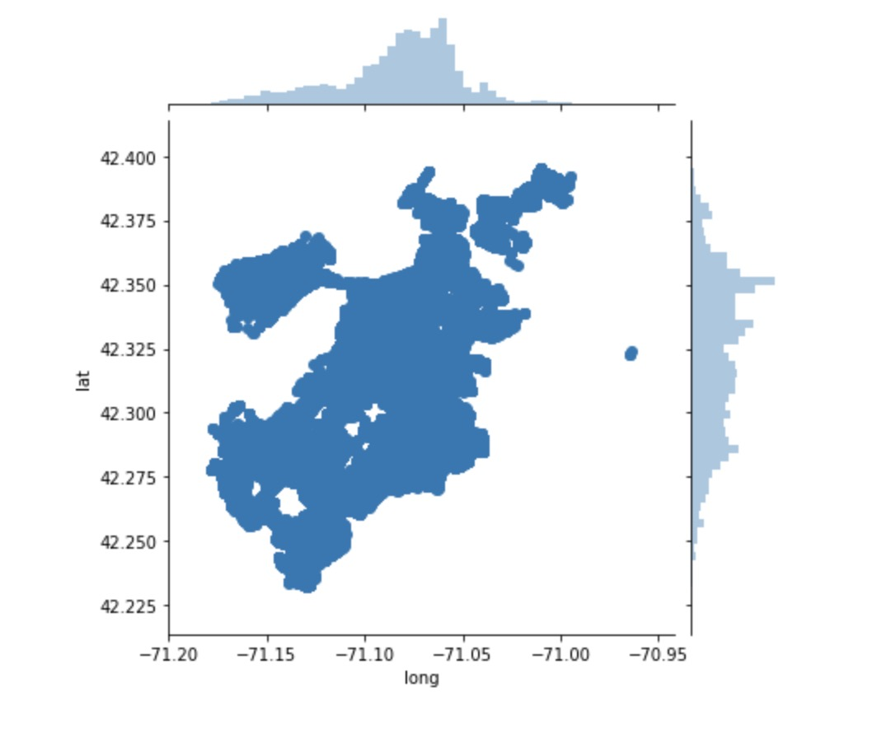
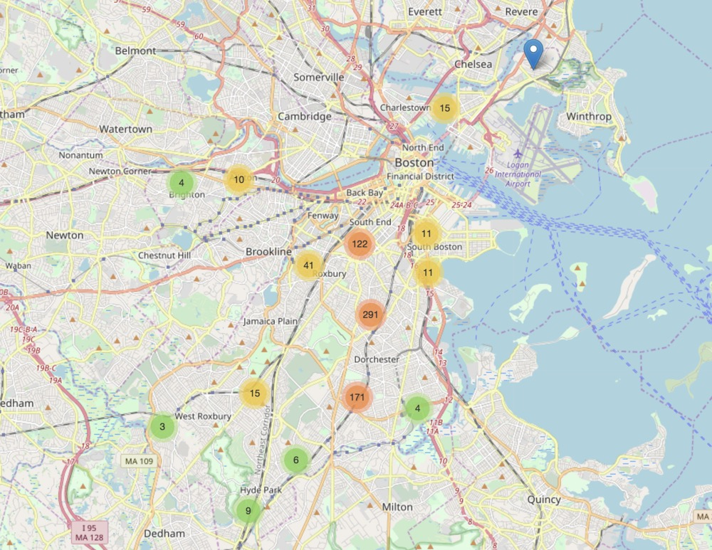
Data Visualization & Interaction
Crime spotting area Geographical distribution
Shooting area interaction page

Slide 7
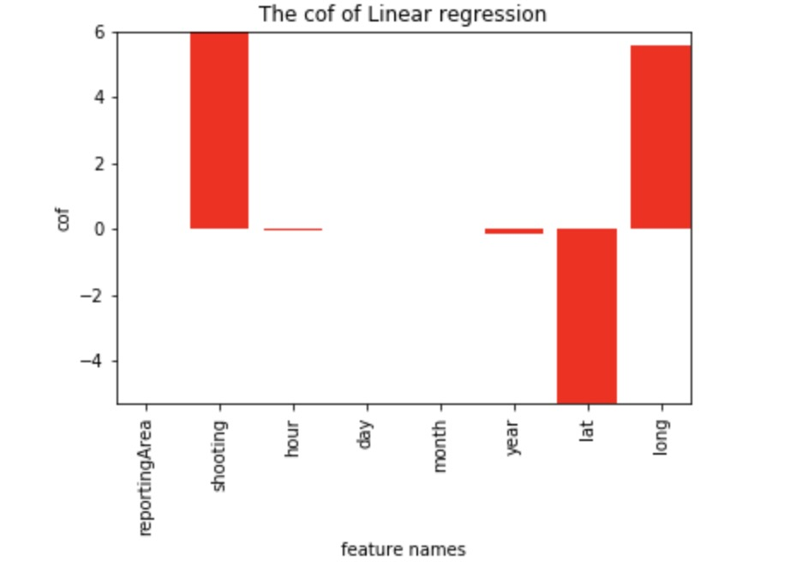
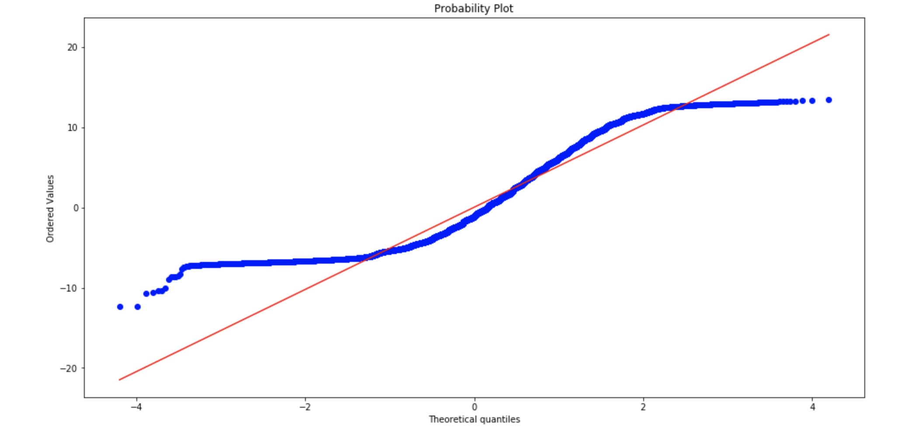
Modeling
1. Regression
1.1 Linear Regression
1.2 Logistic Regression
2. Classification
2.1 Naïve Bayes Classification
2.2 Decision Tree
2.3 Random Forest
3. Neural Network
4. KNN & K-Means
 | Logistic Regression | GaussianNB | BernoulliNB | Kneighbors Classifier | Decesion Tree Classifier | Random Forest Classifier
Accuracy | 0.199 | 0.118 | 0.121 | 0.160 | 0.180 | 0.179
Precision | 0.188 | 0.084 | 0.035 | 0.144 | 0.167 | 0.169
Recall | 0.197 | 0.118 | 0.121 | 0.160 | 0.173 | 0.181
F1 score | 0.153 | 0.050 | 0.029 | 0.138 | 0.169 | 0.168

Slide 8
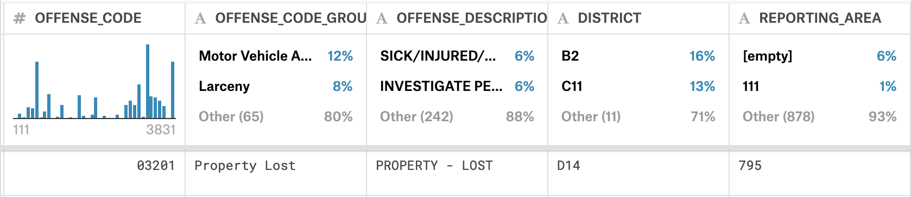
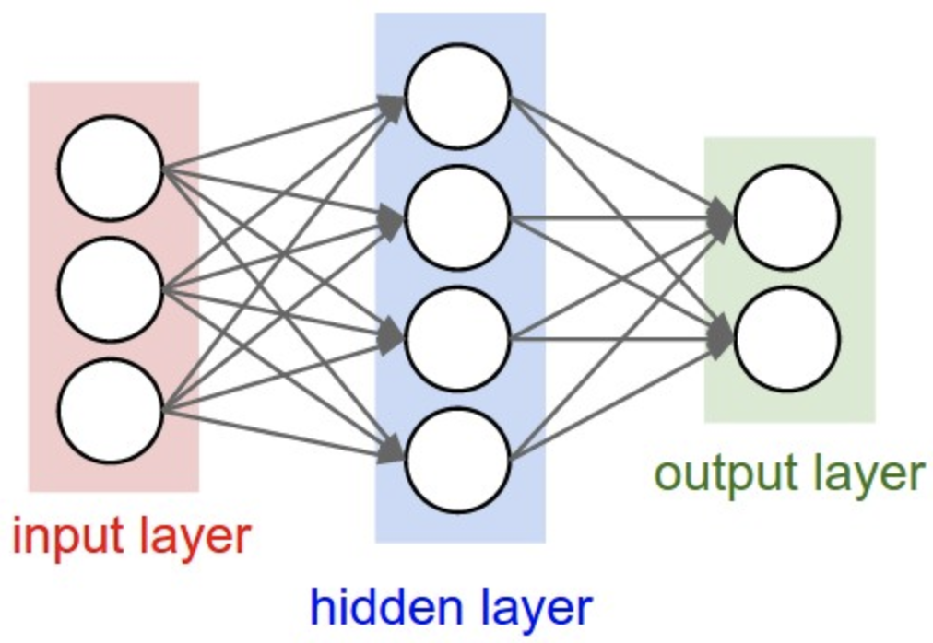
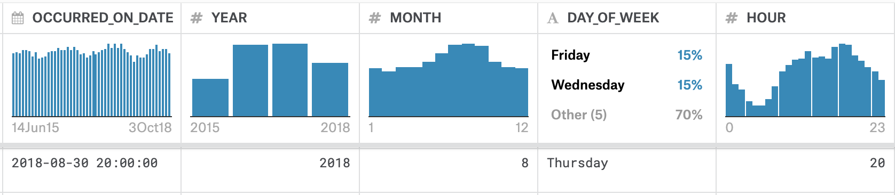
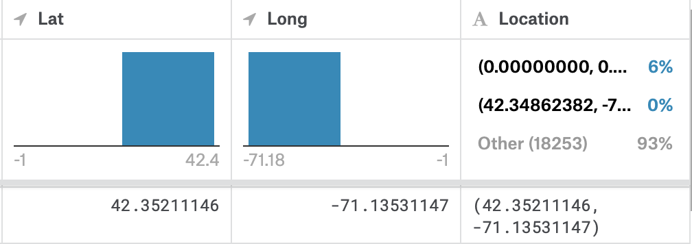
Is it possible to use a neural network to predict crime’s probability?
Input data:
'Year', 'Month', 'Day', 'Hour’, 'Location'(District / Longitude, Latitude)
Output data:
The probability of whether a kind of crime would happen

Slide 9
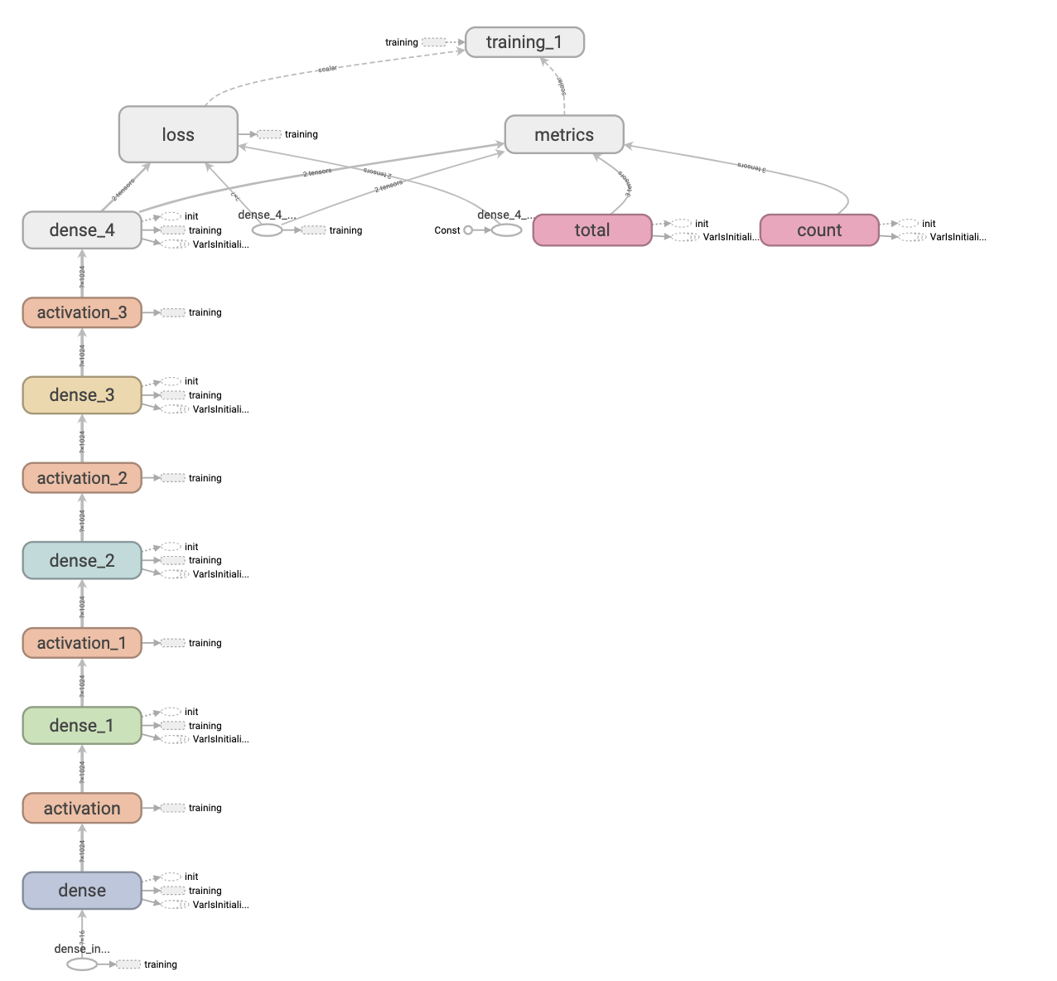
Basic Neural
Network
Softmax
Output
67 Dimensions
Activation
Rectified Linear Unit
Units: 64, 128, 256…
Dense Layer
Dense: 3, 4, 5…
Input
16 Dimensions

Slide 10
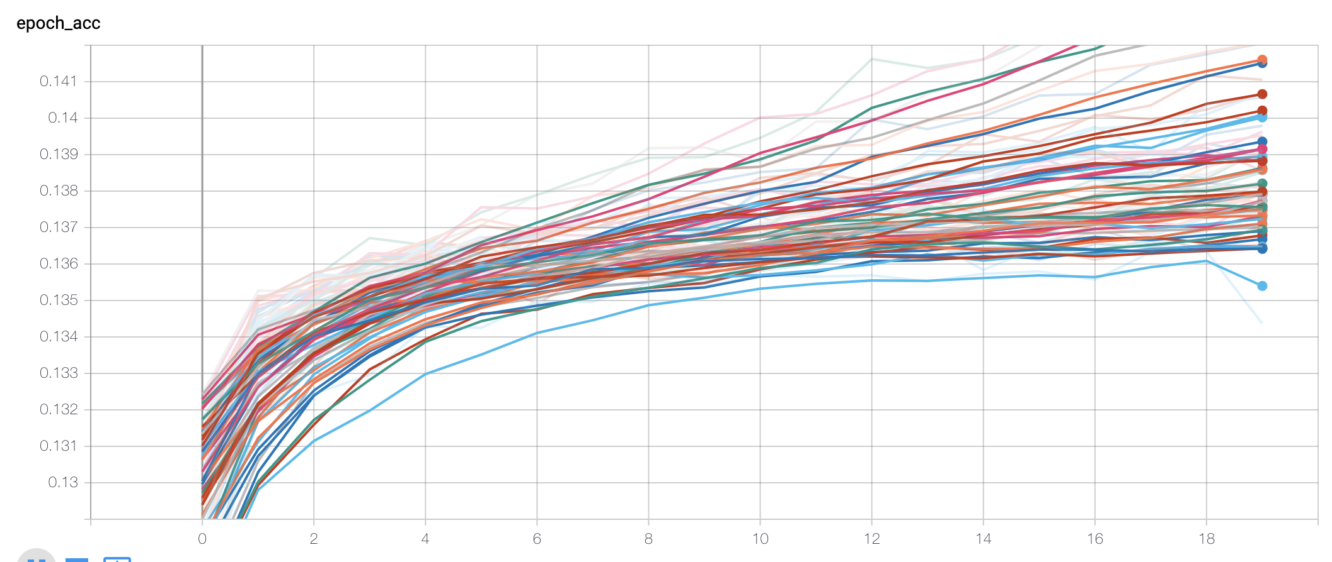
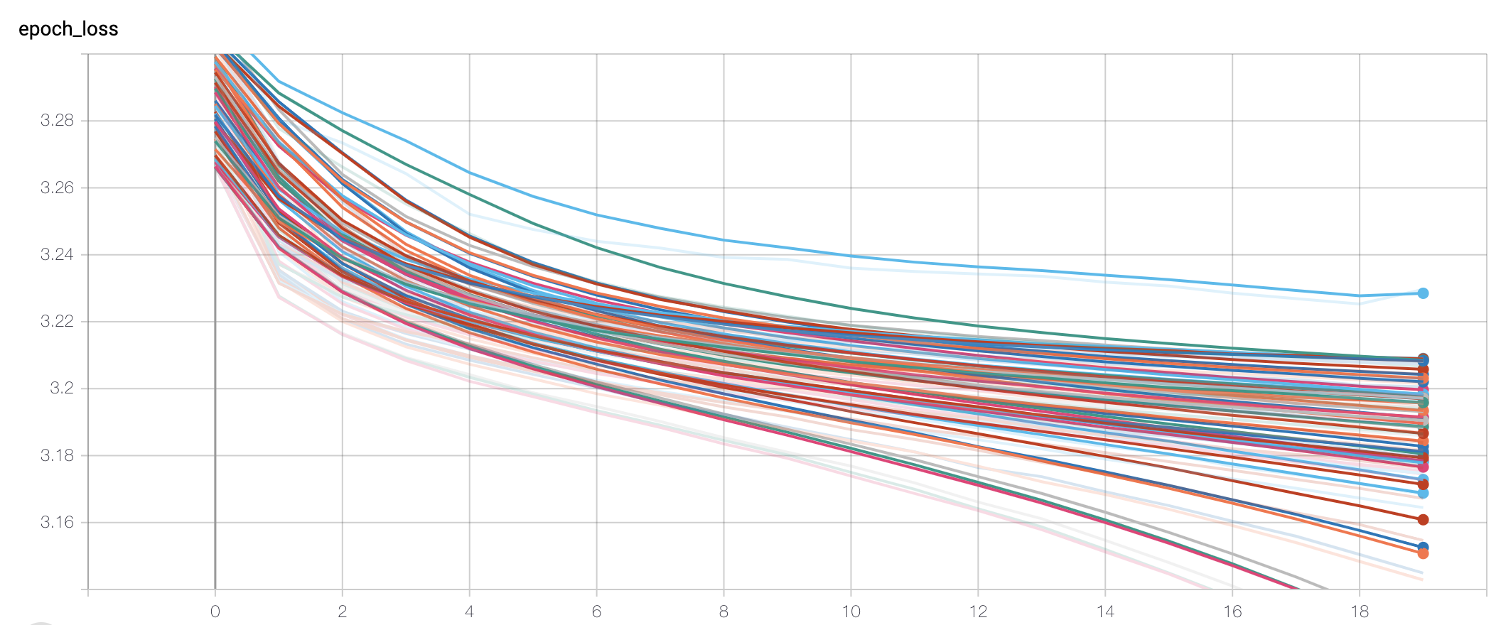
Accuracy and Loss

Slide 11
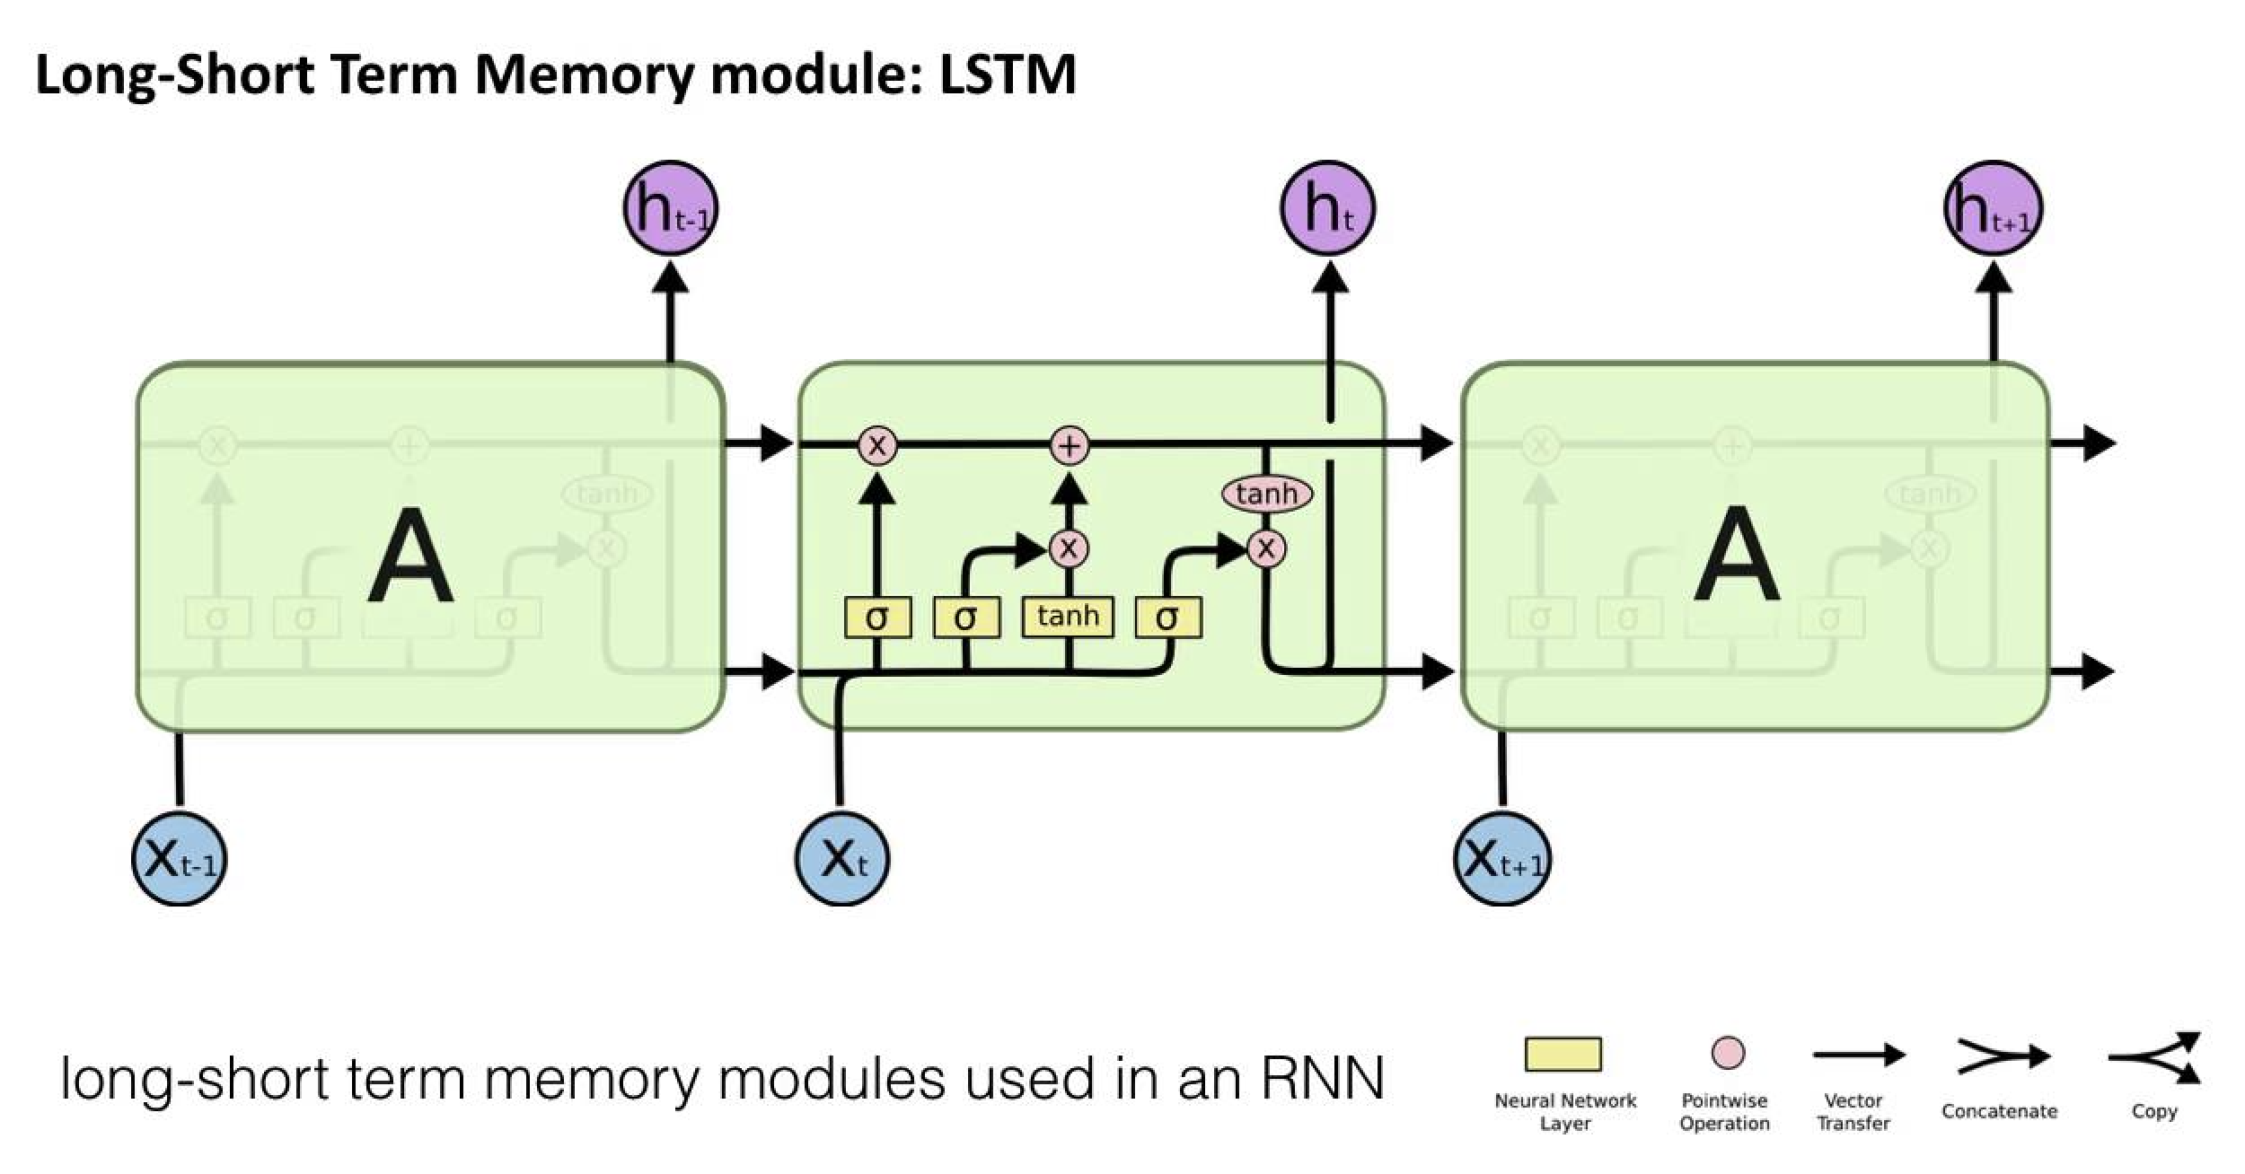
Recurrent Neural Network

Slide 12
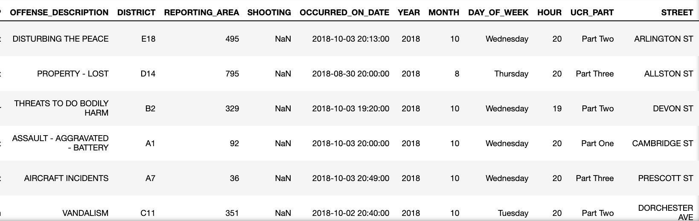
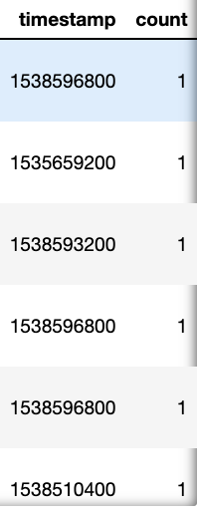
Recurrent Neural Network

Slide 13
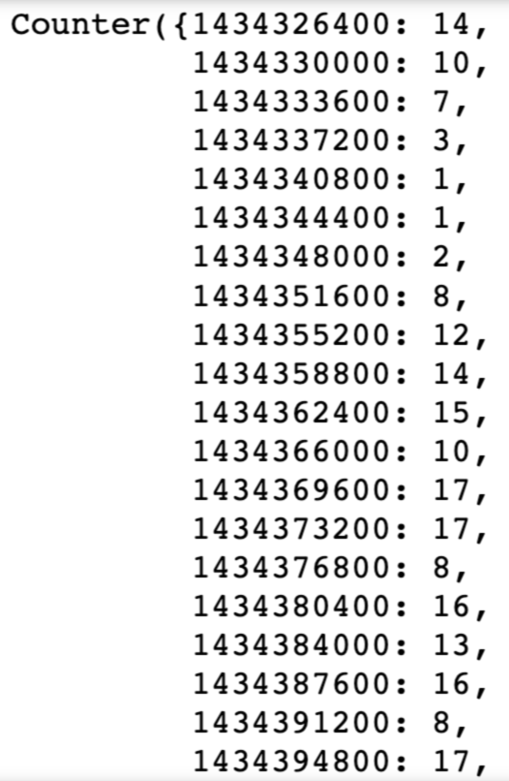
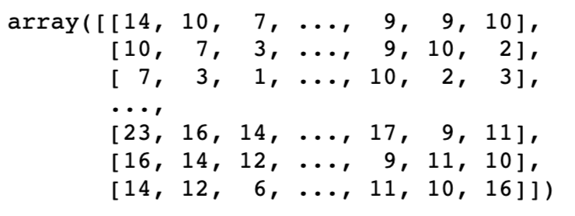
Recurrent Neural Network
72
Input
Output

Slide 14
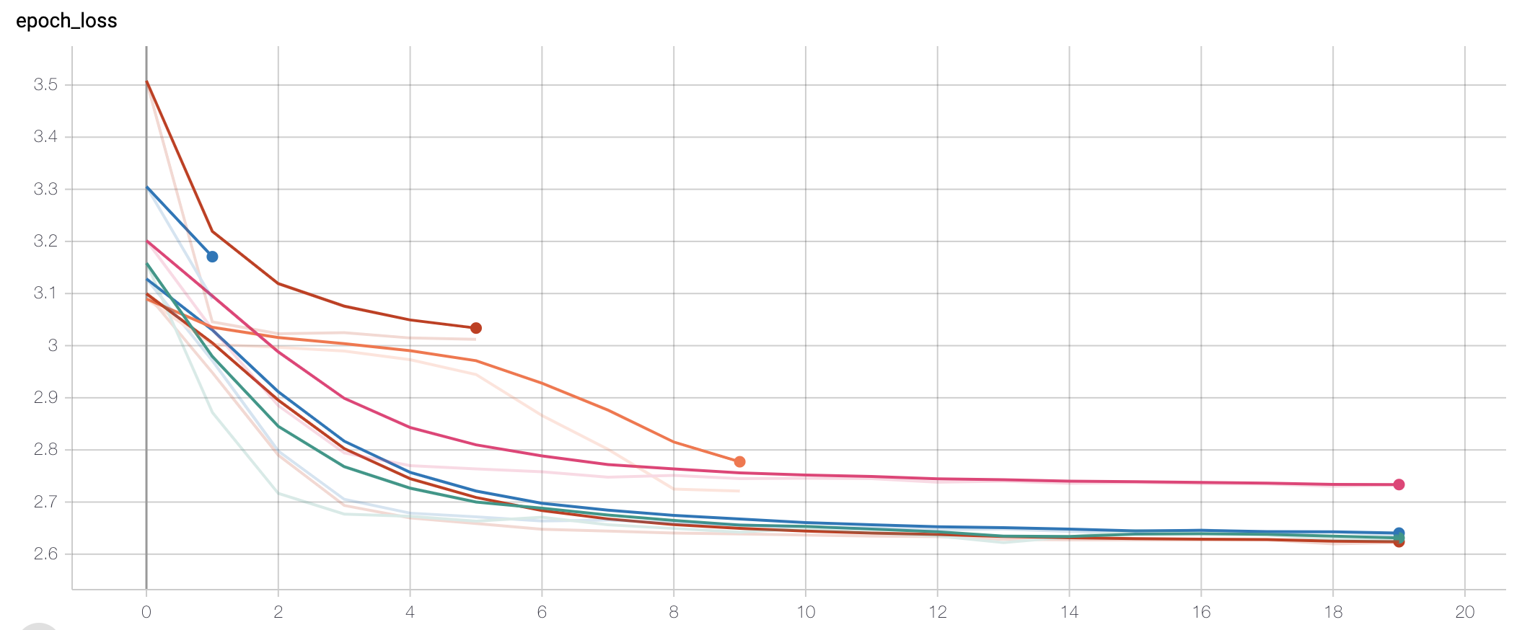
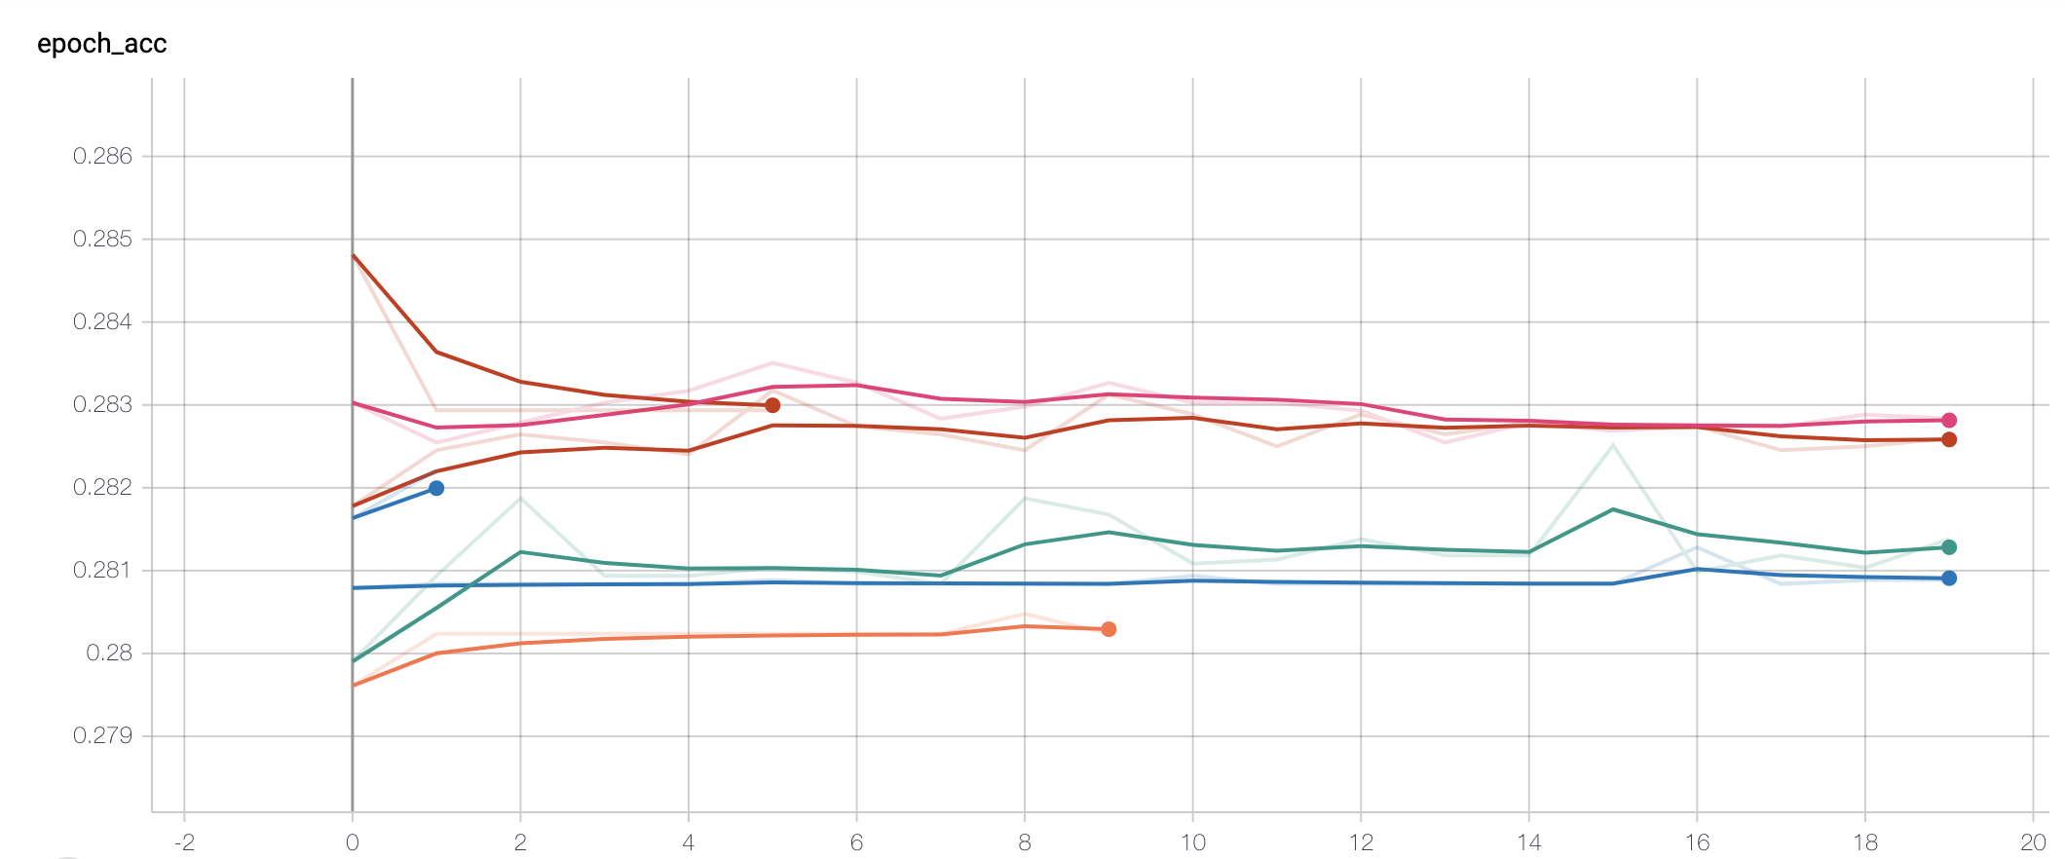
Accuracy and Loss

Slide 15
Future work
Need more data source
Adjust the network structure, parameter
Try to predict general result instead of specific result
Future

Slide 16

THANK YOU

